Slide 1


Slide 2
Business Problem
Fragmented employee data
Manual handoffs
Failure visibility
Employee master data originates in SuccessFactors and must reach the finance landscape reliably.
Manual extraction and file exchange create delays, inconsistency and operational effort.
Processing errors need immediate administrator notification for diagnosis and recovery.
Target state
A controlled CPI integration fetches selected employees, transforms them into the S/4HANA structure, updates the target and provides a payroll-ready SFTP file.
• Scope: SuccessFactors users rharrison and szhou
• Target: S/4HANA EmpdetailsSet
• External delivery: SFTP directory AEH
• Failure path: Exception Subprocess → Gmail
02

Slide 3
Project Objective
• Automate employee master-data synchronization from SuccessFactors to S/4HANA.
• Use SAP Cloud Integration for orchestration, transformation and routing.
• Filter the source to the required user IDs: rharrison and szhou.
• Map source fields into the S/4HANA EmpdetailsSet structure.
• Generate a CSV representation and deliver it to SFTP for payroll processing.
• Notify administrators through Gmail when message processing fails.
Processing completes, target data is written, SFTP receives the file and failures trigger mail.
Success criteria
03

Slide 4
System Landscape
SuccessFactors
Cloud Integration
S/4HANA
SFTP
HR source
OData V2
Orchestration
Mapping / Errors
L4C target
EmpdetailsSet
Payroll handoff
Directory AEH
GMAIL / SMTP
Exception notification
Credential artifacts
SuccessFactors: SFCred_Laxmi • S/4HANA OData: L4C_Cred • SFTP/Mail: assigned personal accounts
04

Slide 5
Solution Architecture
SUCCESSFACTORS
CPI
S/4HANA
CSV
SFTP
OData V2
User
Timer • OData
Mapping • Routing
EmpdetailsSet
OData
Payroll extract
AEH
<First><Last>.csv
EXCEPTION SUBPROCESS
Error → Content Modifier → Mail
Control points
Credentials • filtering • schema validation • mapping • exception notification • monitoring
05

Slide 6
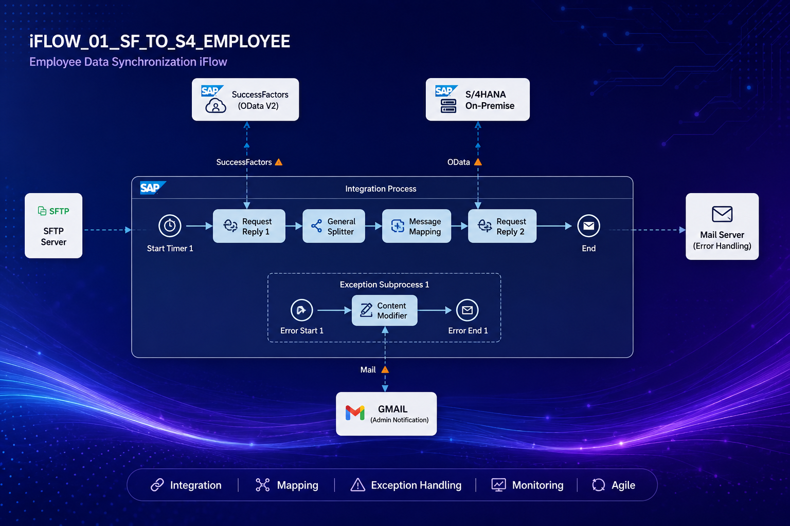

Slide 7
SuccessFactors Configuration
Setting | Value / action | Purpose
Adapter | OData V2 | Read employee data
Credential | SFCred_Laxmi | Training credential
Entity | User | Employee source
Fields | userId, firstName, lastName, country, city | Mapping inputs
Filter | userId eq 'rharrison' or userId eq 'szhou' | Assessment scope
$select | userId,firstName,lastName,country,city | Reduce payload
Important
Validate first
Use the training SuccessFactors connection; do not invent or replace the tenant URL.
Capture the actual OData response in Trace before finalizing the mapping.

Slide 8
Message Mapping
Target | Source | Logic
Mandt | — | Constant = 500
Participantid | firstName + lastName | Concatenate with one space
Sfempname | firstName + lastName | Concatenate with one space
City | city | Direct
Country | country | Direct; uppercase only if target requires it
Mandt
Names
Location
500
firstName + ' ' + lastName
City + Country direct
08

Slide 9
S/4HANA Configuration
Setting | Value
Adapter | OData V2
Proxy Type | On Premise
Location ID | Training L4C location / configured value
Authentication | Basic
Credential | L4C_Cred
Resource Path | EmpdetailsSet
Operation | Create / POST — confirm from service metadata
Service base URL
Target fields
http://awslkm0133.training.accenture.com:8000/sap/opu/odata/sap/ZEMPDET_SRV_SRV/
Mandt • Participantid • Sfempname • City • Country
Validation
Use the adapter's entity/operation selector and service metadata to confirm the exact write operation.
09

Slide 10
Exception Handling
ERROR START
CONTENT MODIFIER
MAIL ADAPTER
ADMINISTRATOR
Any iFlow error
Subject + body
with error details
Gmail / SMTP
Failure alert
Subject
Body
Result
Employee Sync FAILED
Include exception message, flow name and timestamp.
Administrator receives actionable diagnostics.
• Test a controlled failure before submission.
• Do not place passwords or credentials in message bodies or documents.
10

Slide 11
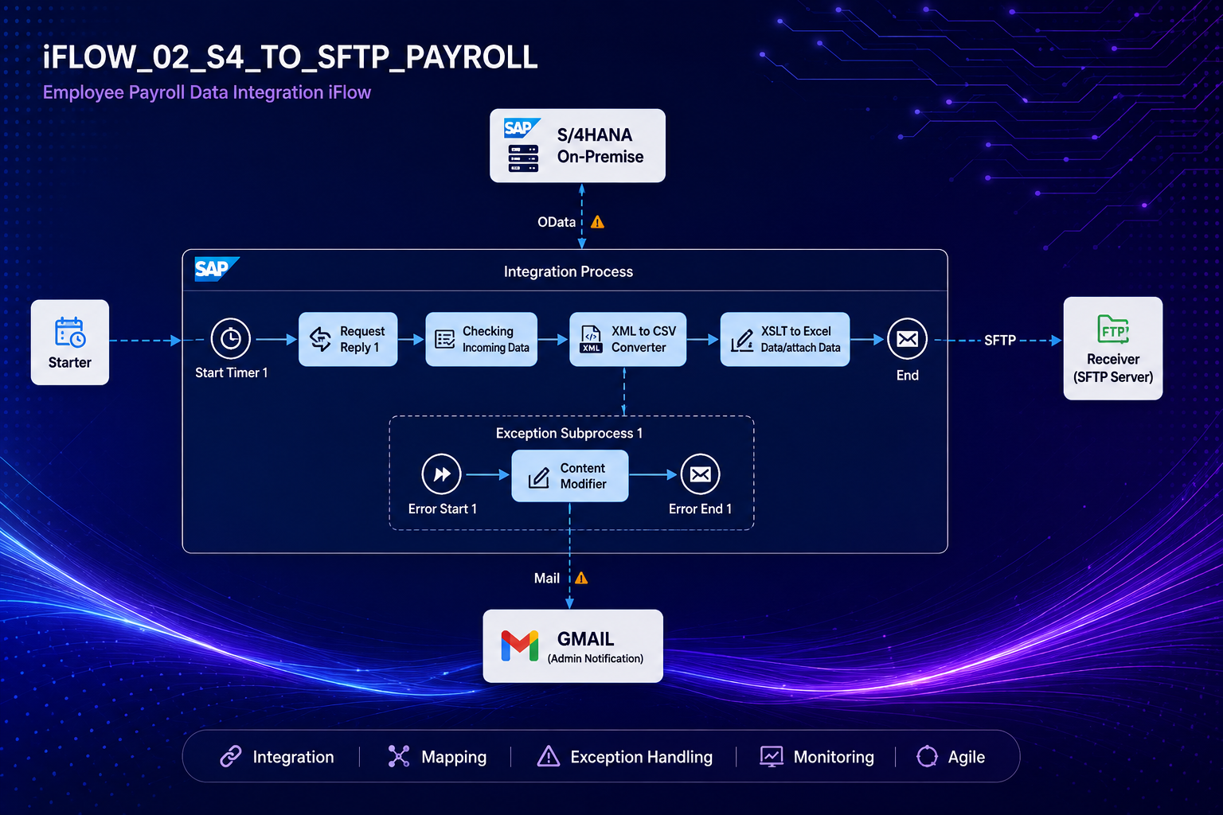

Slide 12
Expected CSV Output
Mandt | Participantid | Sfempname | City | Country
500 | Robert Harrison | Robert Harrison | Dallas | US
500 | Vinod Mudavath | Vinod Mudavath | Hyderabad | IND
Naming convention
Quality checks
YourFirstNameYourLastName.csv
Header order • required values • employee count • valid CSV
12

Slide 13
Testing Strategy
ID | Scenario | Expected result
TC01 | Valid SuccessFactors users | rharrison and szhou are retrieved
TC02 | Message Mapping | Mandt=500; names concatenated; City/Country mapped
TC03 | S/4HANA POST | EmpdetailsSet accepts records
TC04 | CSV generation | Required headers and rows produced
TC05 | SFTP upload | Correctly named file appears in AEH
TC06 | Forced failure | Exception subprocess executes; Gmail alert arrives
TC07 | Monitoring | Message Monitor shows correct processing status
Evidence
Capture deployed flow, successful message, target result, SFTP file and failure email screenshots.
13

Slide 14
Monitoring & Operations
DEPLOYED
MONITOR
TRACE
RECOVERY
Runtime status
Message status
Payload diagnosis
Correct → redeploy → retest
• Save and version the flow before major changes.
• Deploy only after validation/Problems checks are clear.
• Use Monitor → Message Processing to inspect success and failures.
• Use Trace for troubleshooting and keep credentials out of screenshots and documents.
14

Slide 15
Agile / SDLC Execution
1. Requirements
2. Design
3. Development
4. Testing
5. Deployment
6. Maintenance
Scenario + acceptance
Architecture + mapping
Adapters + iFlows
Positive + negative
Version + monitor
Defects + improvement
Artifact | Purpose
Product Backlog | Requirements and acceptance criteria
Sprint Backlog | Adapters, mapping, testing, documentation
Sprint Review | Demonstrate E2E processing and evidence
Retrospective | Record issues, lessons and improvements
15

Slide 16
Challenges & Solutions
Challenge | Solution
SuccessFactors tenant details | Use the training connection/credential; do not invent tenant URLs.
OData entity mismatch | Use service metadata and the adapter's entity selector.
Mapping queue/context errors | Ensure source XML matches the source XSD and target required fields are produced.
S/4HANA connectivity | Use On Premise proxy + correct Location ID + L4C_Cred.
SFTP filename requirement | Follow the exact personal filename convention.
Failure diagnosis | Exception subprocess captures and emails the error.
Key principle
Validate each connection independently before chaining the complete E2E flow.
16

Slide 17
Final Result
SUCCESSFACTORS
CPI
S/4HANA
CSV
SFTP
rharrison
szhou
Filter + Map
+ Route
EmpdetailsSet
Payroll file
AEH
Integration
Reliability
Payroll handoff
Automated synchronization
Exception + email alerting
CSV delivered to SFTP
• Final evidence: deployed iFlows, mail configuration, technical/test documentation, Agile artifacts, repository/version history and demo.
17

Slide 18
